Slide 1

React with Redux

Slide 2
What is a JavaScript Library?
JavaScript libraries are collections of prewritten code snippets that can be used and reused to perform common JavaScript functions.
A particular JavaScript library code can be plugged into the rest of your project’s code on an as-needed basis.
This led to faster development and fewer vulnerabilities to have errors.

Slide 3
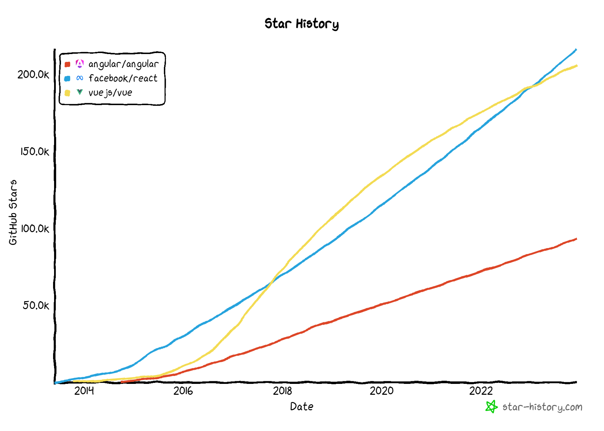

Slide 4
React JS
React JS is a popular JavaScript library for building user interfaces (UIs) for web applications.
It was developed by Facebook and is now maintained by a community of developers.
React JS allows developers to build reusable UI components that can be composed together to create complex, interactive web interfaces.
One of the key features of React JS is its virtual DOM (Document Object Model) implementation, which allows for efficient updates to the UI without having to re-render the entire page. This results in faster performance and a better user experience.
React JS also provides several other features and tools, such as a JSX syntax for writing HTML-like code in JavaScript, a component lifecycle for managing the state and behavior of components, and a powerful set of tools for debugging and testing.
React JS has become a popular choice for web developers due to its flexibility, performance, and ease of use.
It is often used in conjunction with other libraries and frameworks, such as Redux for state management, React Router for navigation, and Next.js for server-side rendering.

Slide 5
Desktop Application
(Cross Platform)
ELECTRON JS
Browser (Client Side)
REACTDOM (CSR)
REACT COMPONENT
React Library
Mobile Application
REACTNATIVE
Server Side
(Node JS App)
REACTDOMSERVER (SSR)

Slide 6
HTML and CSS
HTML and CSS
0
+
-
0
+
-
domHandler
domHandler
Counter
{
count: 0,
next: function() { this.count +=1; } ,
prev: function() { this.count -=1; }
}
Counter
{
count: 0,
next: function() { this.count +=10; } ,
prev: function() { this.count -=10; }
}
<Counter />
<Counter interval=“10”/>

Slide 7
REACT COMPONENT
View* (UI) – JS / JSX
Style (CSS) – JSX / CSS
Data (Inside) – State
Data (Outside) – Props
Behaviour – Methods
(UI Interaction)

Slide 8
UI Composition (Composite UI Pattern)
NAVIGATION
ADVERTISEMENT
MENU ITEM
MENU ITEM
MENU ITEM
MENU ITEM
SIDE NAVIGATION
LIST AREA
DETAILS AREA
STATUS

Slide 9
BROWSER
SERVER
HTTP + URL
NAVIGATION
HTML PAGES
CSS
HTML + CSS
HTTP + URL
HTML + CSS
Page
Reload!

Slide 10
BROWSER
SERVER
HTTP + URL
NAVIGATION
HTML + CSS
Server PAGES
CSS
HTTP + URL
ASP
ASP .NET
JSP
PHP
Ruby
Express JS
HTML + CSS
Page
Reload!
DB

Slide 11
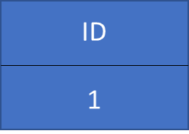
BROWSER
SERVER
HTTP + URL
NAVIGATION
Server PAGES
CSS
HTML + CSS + JS
AJAX - HTTP + URL
JS
Partial
Page
Reload!
PARTIAL HTML
<table>
<thead>
<tr>
<th>ID</th>
</tr>
</thead>
<tbody>
<tr>
<td>1</td>
</tr>
</tbody>
</table>
ASP
ASP .NET
JSP
PHP
Ruby
Express JS
ASP .NET MVC
Spring MVC
Ruby On Rails
Laravel
Sails JS
DB

Slide 12
Single Page Application (SPA)
Client-Side Rendering (CSR)
SERVER
SERVER PAGES
CSS
BROWSER
HTTP + URL
NAVIGATION
JS
HTML + CSS + JS
(Client-Side JS App)
ASP
ASP .NET
JSP
PHP
Ruby
ASP .NET MVC
Spring MVC
Ruby On Rails
Laravel
Sails JS
<table>
<thead>
<tr>
<th>ID</th>
</tr>
</thead>
<tbody>
<tr>
<td>1</td>
</tr>
</tbody>
</table>
SERVER
AJAX - HTTP + URL
RESTful API
ASP .NET Web API
JWS
Express JS
Python
DB
JSON to HTML on Client Side
JSON
{
“id”:1
}
Vanilla JS, jQuery, KO, BB, NG 1,
NG 2 & Above, Vue JS, React JS

Slide 13
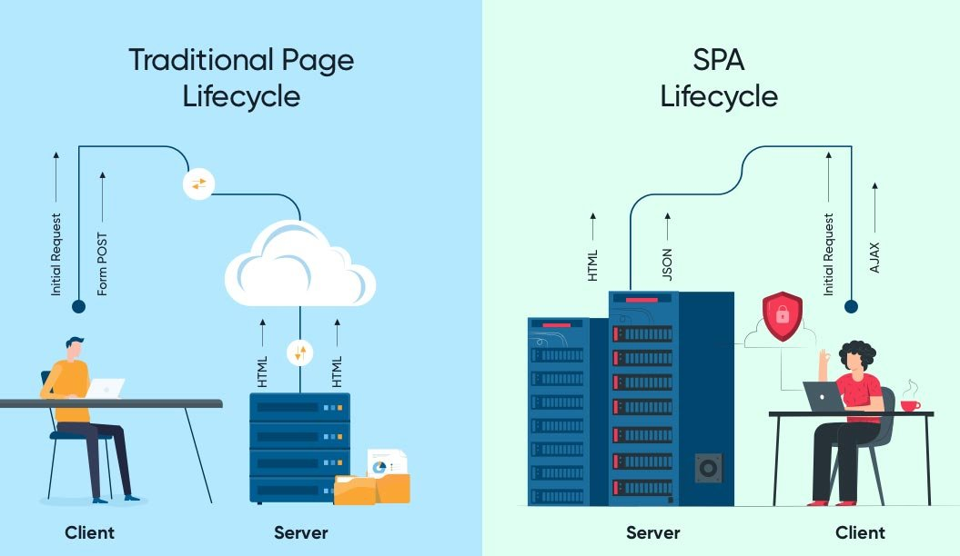

Slide 14
Single Page Application Pros
Quick Loading Time
Seamless User Experience
Ease in Building Feature-rich Apps
Uses Less Bandwidth

Slide 15
Single Page Application Cons (Purely CSR)
Doesn’t Perform Well With SEO
One of the metrics that search engines use is the number of pages a website has. However, since SPAs only load a single page, it serves as a disadvantage when ranking on search engines
Uses a Lot of Browser Resources
SPAs require many resources from the web browser since the browser is doing most of the tasks for the SPAs.
Security Issues
As compared to multi-page apps, SPAs are more prone to cross-site scripting attacks.

Slide 16
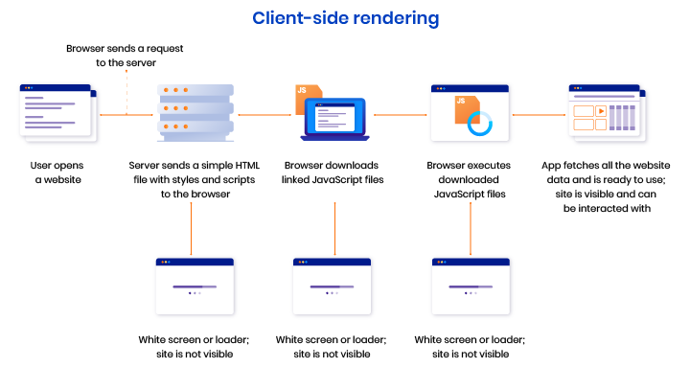

Slide 17
Installation
Install Node LTS (v18) version - https://nodejs.org/en/
Install / Update Visual Studio Code to Latest Release - https://code.visualstudio.com/
Extensions of Visual Studio Code
AutoFileName
vscode-icons
JavaScript (ES6) code snippets
CSS Formatter
IntelliSense for CSS class names in HTML
Reactjs code snippets
After Extensions are installed
File Menu -> Preferences -> Theme -> File Icon Theme -> Select VScode Icons

Slide 18
Browser Extensions Installation
Install Google Chrome Extensions
React Developer Tools
https://chrome.google.com/webstore/detail/react-developer-tools/fmkadmapgofadopljbjfkapdkoienihi
Redux DevTools
https://chrome.google.com/webstore/detail/redux-devtools/lmhkpmbekcpmknklioeibfkpmmfibljd

Slide 19
Client-Side Build
ES 2015 + (JSX)
(Multiple Files)
Manual Configuration
Learn Node
Learn Babel
Learn Webpack
react-scripts
Babel +
Preset (Env) +
Preset (React) +
Polyfill (core-js)
Build & Deploy your
Project on Local Server
npm start
Build your project
npm run build
Auto Configuration
create-react-app (CLI)
Browser Compatible Files
(Multiple Files)
WEBPACK-DEV-
SERVER
WEBPACK
CLI
Bundling
BROWSER
WEBPACK
Single File / Set of Files
Local
HTTP Server
HTML PAGE
Deploy
Inject Bundles

Slide 20
React toolchains
Use an integrated toolchain for the best user and developer experience.
React toolchains help with tasks like:
Scaling to many files and components.
Using third-party libraries from npm.
Detecting common mistakes early.
Live-editing CSS and JS in development.
Optimizing the output for production.

Slide 21
Toolchains
The React team primarily recommends these solutions:
If you’re learning React or creating a new single-page app, use Create React App.
If you’re building a server-rendered website with Node.js, try Next.js.
If you’re building a static content-oriented website, try Gatsby.

Slide 22
Create React App
Create React App is a comfortable environment for learning React and is the best way to start building a new single-page application in React.
It sets up your development environment so that you can use the latest JavaScript features, provides a nice developer experience, and optimizes your app for production.
You’ll need to have Node >= 14.0.0 and npm >= 5.6 on your machine.
Create React App doesn’t handle backend logic or databases; it just creates a frontend build pipeline, so you can use it with any backend you want. Under the hood, it uses Babel and webpack, but you don’t need to know anything about them.
When you’re ready to deploy to production, running npm run build will create an optimized build of your app in the build folder.

Slide 23
Using React CLI
To Create a new application
npx create-react-app first-app
cd first-app
Commands available in the application
npm start
Starts the development server.
npm run build
Bundles the app into static files for production.
npm run test
Starts the test runner.
npm run eject
Removes this tool and copies build dependencies, configuration files and scripts into the app directory. If you do this, you can’t go back!

Slide 24
Using Bootstrap
Install
npm i bootstrap
npm i bootstrap-icons
Or
npm i bootstrap bootstrap-icons
Include bootstrap and bootstrap-icons CSS file in index.js
Include bootstrap module in index.js

Slide 25
Assignment
Create and render the following components
Component One
Hello from Component One (text-success)
Component Two
Hello from Component Two (text-primary)

Slide 26
Render Both Components Using a Single ReactDOM.render
Key Points:
Both ComponentOne and ComponentTwo are rendered directly within a div element.
There is no parent component that can manage their state or facilitate communication between them.
If ComponentOne needs to communicate with ComponentTwo (e.g., share state), it becomes challenging because there is no shared parent to handle this.

Slide 27
Render both Components using two different ReactDOM.render
Key Points
Each component is rendered separately in different DOM elements.
Two separate ReactDOM.render calls are made, each targeting a different root element in the HTML.
Useful if you need to render components in different parts of the HTML document.
Allows for isolated updates if the components don't need to interact with each other.

Slide 28
Render Both Components in Root and Render Root Using ReactDOM.render
Key Points:
Both ComponentOne and ComponentTwo are rendered inside an App component.
The App or Root component serves as a parent component that can manage state and facilitate communication between ComponentOne and ComponentTwo.
The App or Root component can pass props or use context to manage and share state between its children.

Slide 29
Ways to Style React Components
There are different ways to styling React JS components. Few of them are:
Inline Styles
In inline styling basically we create objects of style. And render it inside the components in style attribute using the React technique to incorporate JavaScript variable inside the JSX (Using ‘{ }’ )
Normal (External) CSS
In the external CSS styling technique, we basically create an external CSS file for each component and do the required styling of classes.
And use those class names inside the component.
It is a convention that name of the external CSS file same as the name of the component with ‘.css’ extension.
It is better if the name of the classes used, follow the format ‘componentName-context’ (here context signifies where we use this classname).
CSS module
A CSS module is a simple CSS file but a key difference is by default when it is imported every class name and animation inside the CSS module is scoped locally to the component that is importing it also CSS file name should follow the format ‘filename.module.css’.
This allows us to use a valid name for CSS classes without worrying about conflicts with other class names in your application.
Styled Components
The styled-components allows us to style the CSS under the variable created in JavaScript.
Style components is a third-party package using which we can create a component as a JavaScript variable that is already styled with CSS code and used that styled component in our main component.
styled-components allow us to create custom reusable components which can be less of a hassle to maintain.

Slide 30
State
The state is an updatable structure that is used to contain data or information about the component and can change over time.
The change in state can happen as a response to user action or system event.
It is the heart of the react component which determines the behavior of the component and how it will render.
It represents the component's local state or information.
It can only be accessed or modified inside the component or by the component directly.

Slide 31
Props
Props are read-only structure.
It is an object which stores the value of attributes of a component and work similar to the HTML attributes.
It allows passing data from one component to other components.
Props are immutable so we cannot modify the props from inside the component.

Slide 32
Props vs State
Props | State
Props are read-only. | State changes can be asynchronous.
Props are immutable. | State is mutable.
Props allow you to pass data from one component to other components as an argument. | State holds information about the components.
Props can be accessed by the child component. | State cannot be accessed by child components.
Props are used to communicate between components. | States can be used for rendering dynamic changes within the component.
Props make components reusable. | State cannot make components reusable.
Props are external and controlled by whatever renders the component. | The State is internal and controlled by the React Component itself.

Slide 33
Type checking With PropTypes
As your app grows, you can catch a lot of bugs with typechecking.
To run typechecking on the props for a component, you can assign the special propTypes property.
React.PropTypes has moved into a different package since React v15.5.
Use prop-types library
npm i prop-types
PropTypes exports a range of validators that can be used to make sure the data you receive is valid.

Slide 34
How Browser Renders a Web Page?
DOM
HTML Parser
DOM Tree
Layout
HTML
Attachment
Render Tree
Painting
Display
CSS
CSS Parser
Style Rules (CSSOM)

Slide 35
Solution – Virtual DOM
Virtual DOM is an in-memory representation of real DOM.
It is a lightweight JavaScript object which is a copy of Real DOM.
Whenever setState() method is called, ReactJS creates the whole Virtual DOM from scratch.
At any given time, ReactJS maintains two virtual DOM, one with the updated state Virtual DOM and other with the previous state Virtual DOM.
ReactJS using diff algorithm compares both the Virtual DOM to find the minimum number of steps to update the Real DOM.

Slide 36
Virtual DOM
Updating virtual DOM in ReactJS is faster because ReactJS uses
Efficient diff algorithm
Batched update operations
Efficient update of subtree only
Uses observable instead of dirty checking to detect the change

Slide 37
props
Call setState()
React Component
(state)
Render function of the
Component is called by
Event Fired
ReactDOM
Ready for User Interaction
DELTA’s will be rendered and Browser DOM will update
Virtual DOM
New Virtual DOM is compared with the Old Virtual DOM
DELTA’s

Slide 38
SyntheticEvent Object
Your event handlers will be passed instances of SyntheticEvent, a cross-browser wrapper around the browser’s native event.
It has the same interface as the browser’s native event, including stopPropagation() and preventDefault(), except the events work identically across all browsers.
The synthetic events are different from, and do not map directly to, the browser’s native events.

Slide 39
SyntheticEvent object attributes
boolean bubbles
boolean cancelable
DOMEventTarget currentTarget
boolean defaultPrevented
number eventPhase
boolean isTrusted
DOMEvent nativeEvent
void preventDefault()
boolean isDefaultPrevented()
void stopPropagation()
boolean isPropagationStopped()
void persist()
DOMEventTarget target
number timeStamp
string type

Slide 40
Methods & Properties in a React Component Class
Instance Methods
constructor()
render()
setState()
componentDidMount()
componentDidUpdate()
shouldComponentUpdate()
getSnapshotBeforeUpdate()
forceUpdate()
componentDidCatch()
componentWillUnmount()
Instance Properties
state
props
context
Class Methods (static)
getDerivedStateFromProps()
getDerivedStateFromError()
Class Properties (static)
defaultProps
propTypes
displayName
contextType

Slide 41
Lifecycle Methods in a React Component Class
Mounting Phase (Once)
constructor()
static getDerivedStateFromProps()
render()
componentDidMount()
Updating Phase (On Changes)
static getDerivedStateFromProps()
shouldComponentUpdate()
render()
getSnapshotBeforeUpdate()
componentDidUpdate()
Unmounting Phase (Once)
componentWillUnmount()
Error Phase (Once)
componentDidCatch()
static getDerivedStateFromError()

Slide 42
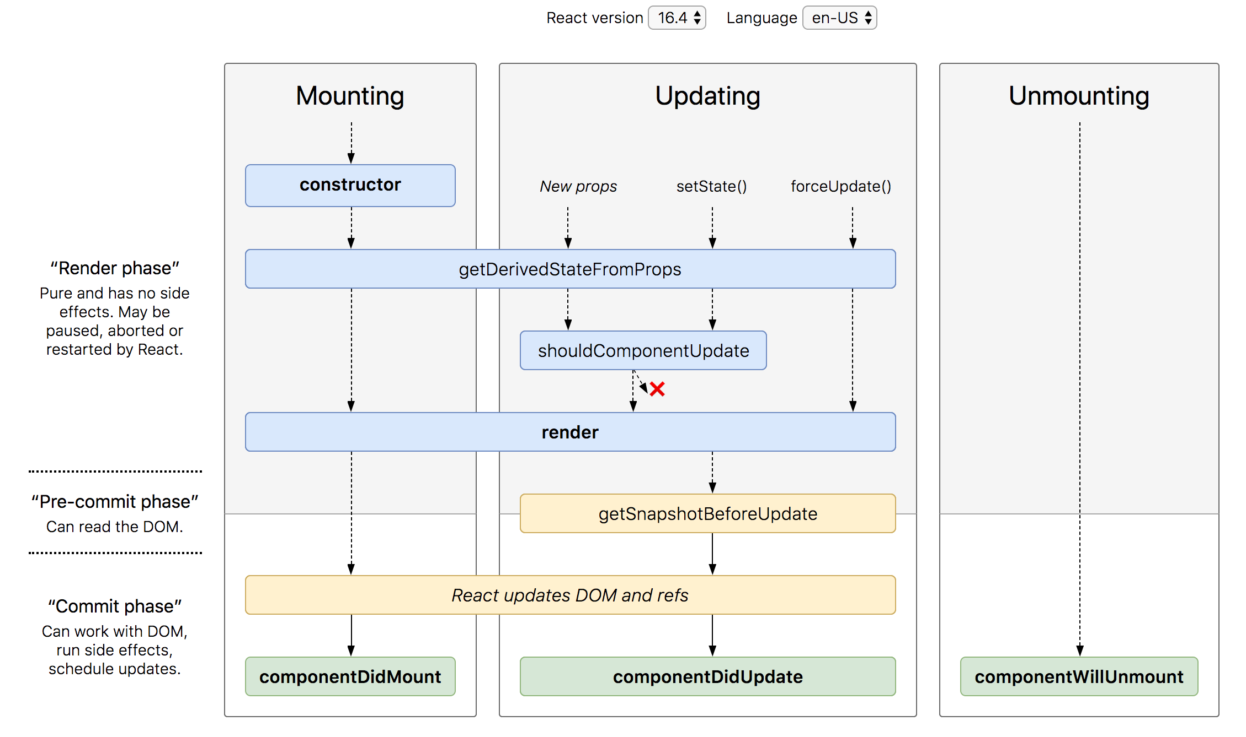
Lifecycle Methods

Slide 43
STATE
UI
X
Use Event to change State

Slide 44
Parent Child Communication
PARENT
PARENT
Parent
Method
Reference
props
refs
CHILD
CHILD

Slide 45
Rules to remember
The UI will update, only when setState() is called to modify the state.
The state of a component, can be modified only by the method of the same component using setState().
Never create a data in the state, if you are not using it on the UI.
The data flows unidirectionally in React,
from state to the template of the component
or
from parent to child.

Slide 46
Sibling Communication Using Parent State
Parent Component
State
Parent Method Reference – I will change the state of the parent component
props
CHILD Component
1
CHILD Component
2

Slide 47
Controlled Component
A controlled component is bound to a value, and its changes will be handled in code by using event-based callbacks.
The input form element is handled by the react itself rather than the DOM.
The mutable state is kept in the state property and will be updated only with setState() method.
Controlled components have functions that govern the data passing into them on every onChange event occurs.
The data is then saved to state and updated with setState() method. It makes component have better control over the form elements and data.

Slide 48
Uncontrolled Component
It is similar to the traditional HTML form inputs. Here, the form data is handled by the DOM itself.
It maintains their own state and will be updated when the input value changes.
To write an uncontrolled component, there is no need to write an event handler for every state update.
You can use a ref to access the value of the form from the DOM.

Slide 49
Controlled vs Uncontrolled
Controlled | Uncontrolled
It does not maintain its internal state. | It maintains its internal states.
Here, data is controlled by the parent component. | Here, data is controlled by the DOM itself.
It accepts its current value as a prop. | It uses a ref for their current values.
It allows validation control. | It does not allow validation control.
It has better control over the form elements and data. | It has limited control over the form elements and data.

Slide 50
Error Boundaries
If the errors are not handled, the react component will crash and show a blank UI (in production mode).
Error boundaries are React components that catch JavaScript errors anywhere in their child component tree, log those errors, and display a fallback UI instead of the component tree that crashed.
Error boundaries catch errors during rendering, in lifecycle methods, and in constructors of the whole tree below them.
Error boundaries do not catch errors for:
Event handlers
Asynchronous code (e.g. setTimeout or requestAnimationFrame callbacks)
Server side rendering
Errors thrown in the error boundary itself (rather than its children)

Slide 51
Create an Error Boundary
A class component becomes an error boundary if it defines either (or both) of the lifecycle methods static getDerivedStateFromError() or componentDidCatch()
Use static getDerivedStateFromError() to render a fallback UI after an error has been thrown.
Use componentDidCatch() to log error information.
The granularity of error boundaries is up to you.
You may wrap top-level components to display a “Something went wrong” message to the user, just like how server-side frameworks often handle crashes.
You may also wrap individual components in an error boundary to protect them from crashing the rest of the application.

Slide 52
Context
In a typical React application, data is passed top-down (parent to child) via props, but such usage can be cumbersome for certain types of props that are required by many components within an application.
Context provides a way to share values between components without having to explicitly pass a prop through every level of the tree.

Slide 53
Counter Sibling Communication using Context
Parent Component
Counter
Context
Counter
CounterSibling

Slide 54
Assignment
Complete the CRUD assignment as per the screenshot shared in the next slide, use array to keep the data.
Create form-component and data-table-component as sibling components.
Id should be auto generated after every insert, update and delete
When we click details or edit, data will be displayed in Form Component.
In Details, Form should display the data, but the form will be disabled for editing.
On delete, ask for confirmation, before delete
Second, Use Context API to Share Data between both the components.

Slide 55
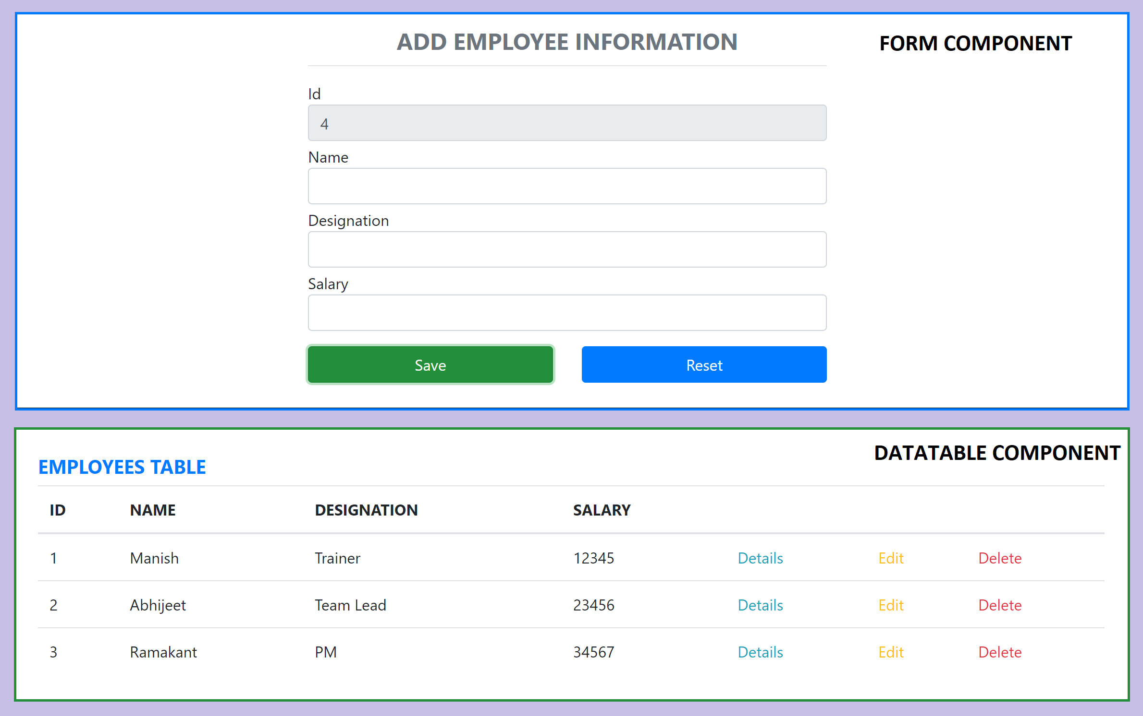
Assignment

Slide 56
AJAX and APIs
You can use any AJAX library you like with React.
Some popular libraries are:
Axios
jQuery AJAX
window.fetch
XMLHttpRequest
You should populate data with AJAX calls in the commit phase lifecycle methods like componentDidMount().
Use setState to update your component when the data is retrieved.

Slide 57
Hooks
Hooks are a new addition in React 16.8.
Hooks let you use state and other React features without writing a class.
Hooks are backwards-compatible
Built in Hooks
Basic Hooks
useState
useEffect
useContext
Additional Hooks
useReducer
useCallback
useMemo
useRef
useImperativeHandle
useLayoutEffect
useDebugValue

Slide 58
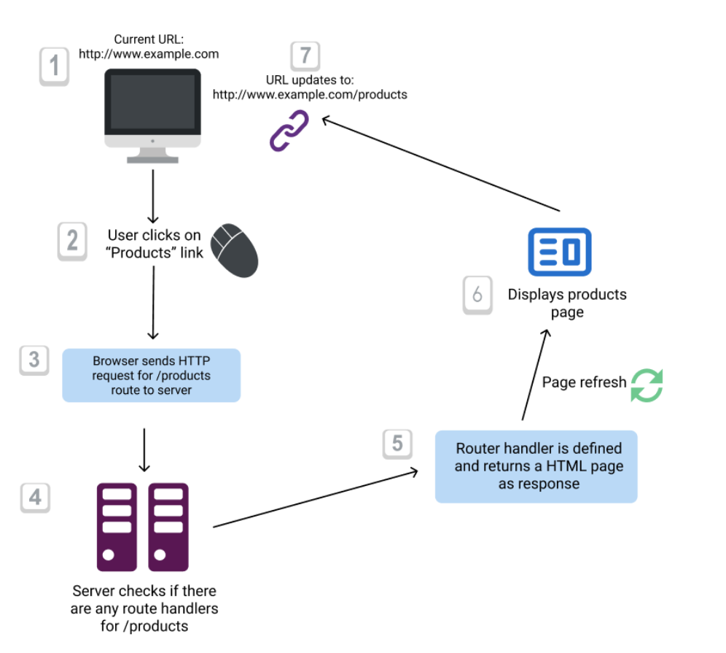
Conventional Routing

Slide 59
React Router
React Router is the de-facto React routing library, and it’s one of the most popular projects built on top of React.
React at its core is a very simple library, and it does not dictate anything about routing.
Routing in a Single Page Application is the way to introduce some features to navigating the app through links, which are expected in normal web applications:
The browser should change the URL when you navigate to a different screen
Deep linking should work: if you point the browser to a URL, the application should reconstruct the same view that was presented when the URL was generated.
The browser back (and forward) button should work like expected.
Routing links together your application navigation with the navigation features offered by the browser: the address bar and the navigation buttons.
React Router offers a way to write your code so that it will show certain components of your app only if the route matches what you define.

Slide 60
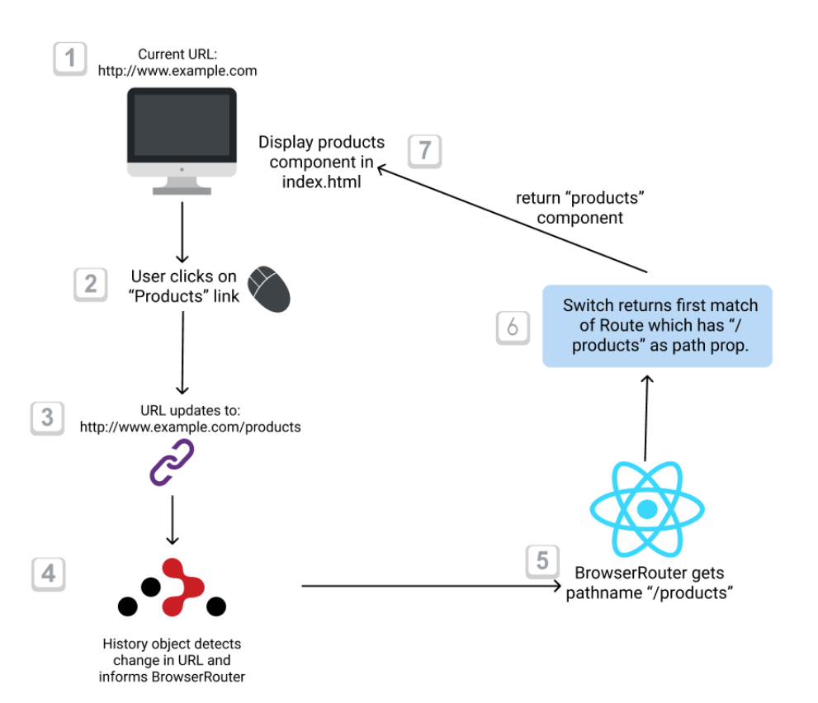
React Client-side Routing

Slide 61
Router Components
Install
npm i react-router-dom
The 3 components you will interact the most when working with React Router are:
BrowserRouter wraps all your Route components.
Link/NavLink components are used to generate links to your routes
Route components are responsible for showing - or hiding - the components they contain.

Slide 62
NODE SERVER
BROWSER
HTTP + URL (localhost:3000)
NAVIGATION
React Application
HTML Page + JS (React App)
NODE SERVER
EXPRESS JS
Web API
AJAX – localhost:8000/api/products
Database
JSON

Slide 63
How is it working?
User Clicks on Admin Link, React router maps the URL and displays the AdminComponent.
On componentDidMount, Call to the API is done to access Data from the API Server.
On success of the API call, the data is displayed in AdminComponent using DataTable Component.
On error, AdminComponent shows error messages.

Slide 64
NODE SERVER
BROWSER
HTTP + URL (localhost:3000)
NAVIGATION
React Application
HTML Page + JS (React App)
HTTP + URL (AJAX) + Username & Password
NODE SERVER
EXPRESS JS
Web API
JSON with Token
{“token”:”___”}
AJAX – localhost:8000/api/products + Token
Database
JSON

Slide 65
Secure Application using Custom Route
When user clicks the Admin Link, we need to verify that we have a token in session storage, and if the token in not there in the session storage, redirect the request to login component. (SecuredRoute)
SecuredRoute uses AuthenticatorClient’s isAuthenticated to verify.
If false, the request is redirected to Login Component.
If true, the request is allowed for Admin Component.
Logging and Token Management (AuthenticatorClient)
On Login Component, user must give username and password, which will be sent to Node API Server
If the username & password is correct, in the response; token will come from the Server
Received token will be stored in the session storage of the browser and isAuthenticated will be set to true.
Reading and Attaching Token
Whenever the AJAX request is made for api, we must read and attach the token in the request header.
We use AuthenticatorClient readToken() to read the token from session storage.

Slide 66
Fetch Interceptor
Interceptors are an excellent way to modify the HTTP request or response to make it more simple and understandable.
fetch-intercept monkey patches the global fetch method and allows you the usage in Browser, Node and Webworker environments.
https://www.npmjs.com/package/fetch-intercept
HTTP
Request
Interceptor
HTTP
Request
React Application
Server
HTTP
Response
HTTP
Response
We can manipulate or modify
the request or response

Slide 67
Secure Application using Custom Route
When user clicks the Admin Link, we need to verify that we have a token in session storage, and if the token in not there in the session storage, redirect the request to login component. (SecuredRoute)
SecuredRoute uses AuthenticatorClient’s isAuthenticated to verify.
If false, the request is redirected to Login Component.
If true, the request is allowed for Admin Component.
Logging and Token Management (AuthenticatorClient)
On Login Component, user must give username and password, which will be sent to Node API Server
If the username & password is correct, in the response; token will come from the Server
Received token will be stored in the session storage of the browser and isAuthenticated will be set to true.
Reading and Attaching Token (Fetch Interceptor)
Whenever the AJAX request is made for api, we must read and attach the token in the request header.
We use AuthenticatorClient getToken() to read the token from session storage.

Slide 68
HOC (Higher Order Components)
HOC is a pattern that emerges from React’s compositional nature.
A higher-order component (HOC) is an advanced technique in React for reusing component logic.
Component transforms props into UI, a higher-order component transforms a component into another component.
A higher-order component is a function that takes a component and returns a new component.

Slide 69
Why HOC?
Reason to use Higher-Order component:
Easy to handle
Get rid of copying the same logic in every component
Makes code more readable

Slide 70
Questions
When 2 or more components want to share data, where should we keep the data?
Parent Component
Context API (Provider & Consumer)
How will you maintain data related to multiple subcomponents in an application?
Multiple Contexts
How will you manage all the contexts in the application?

Slide 71
Redux
Redux is a pattern and library for managing and updating application state, using events called "actions".
It serves as a centralized store for state that needs to be used across your entire application, with rules ensuring that the state can only be updated in a predictable fashion.
The patterns and tools provided by Redux make it easier to understand when, where, why, and how the state in your application is being updated, and how your application logic will behave when those changes occur.

Slide 72
When Should I Use Redux?
Redux helps you deal with shared state management, but like any tool, it has tradeoffs. There are more concepts to learn, and more code to write. It also adds some indirection to your code and asks you to follow certain restrictions. It's a trade-off between short term and long-term productivity.
Redux is more useful when:
You have large amounts of application state that are needed in many places in the app
The app state is updated frequently over time
The logic to update that state may be complex
The app has a medium or large-sized codebase, and might be worked on by many people
Not all apps need Redux. Take some time to think about the kind of app you're building and decide what tools would be best to help solve the problems you're working on.

Slide 73
Redux Terminology
Actions - An action is a plain JavaScript object that has a type field. You can think of an action as an event that describes something that happened in the application.
Action Creators - An action creator is a function that creates and returns an action object. We typically use these, so we don't have to write the action object by hand every time
Reducers - A reducer is a function that receives the current state and an action object, decides how to update the state if necessary, and returns the new state. You can think of a reducer as an event listener which handles events based on the received action (event) type.
Store - The current Redux application state lives in an object called the store . The store is created by passing in a reducer.
Dispatch - The Redux store has a method called dispatch. The only way to update the state is to call store.dispatch() and pass in an action object. The store will run its reducer function and save the new state value inside. You can think of dispatching actions as "triggering an event" in the application.
Selectors - Selectors are functions that know how to extract specific pieces of information from a store state value.

Slide 74
REACT COMPONENT → DISPATCHER (ACTION) → REDUCER → STORE →REACT COMPONENT
REACT COMPONENT → DISPATCHER (ACTION) → MIDDLEWARE → REDUCER → STORE →REACT COMPONENT

Slide 75

Redux Application Data Flow

Slide 76
Thunk Middleware – Async Data Flow
Thunk is a logical concept in programming where you deal with a function that is primarily used to delay the calculation or evaluation of any operation.
Redux Thunk acts as a middleware that will return you a function instead of an object while calling through the action creators.
The returned function receives the dispatch method from the store and then later it is used to dispatch synchronously inside the body of function once the asynchronous actions have been completed.

Slide 77
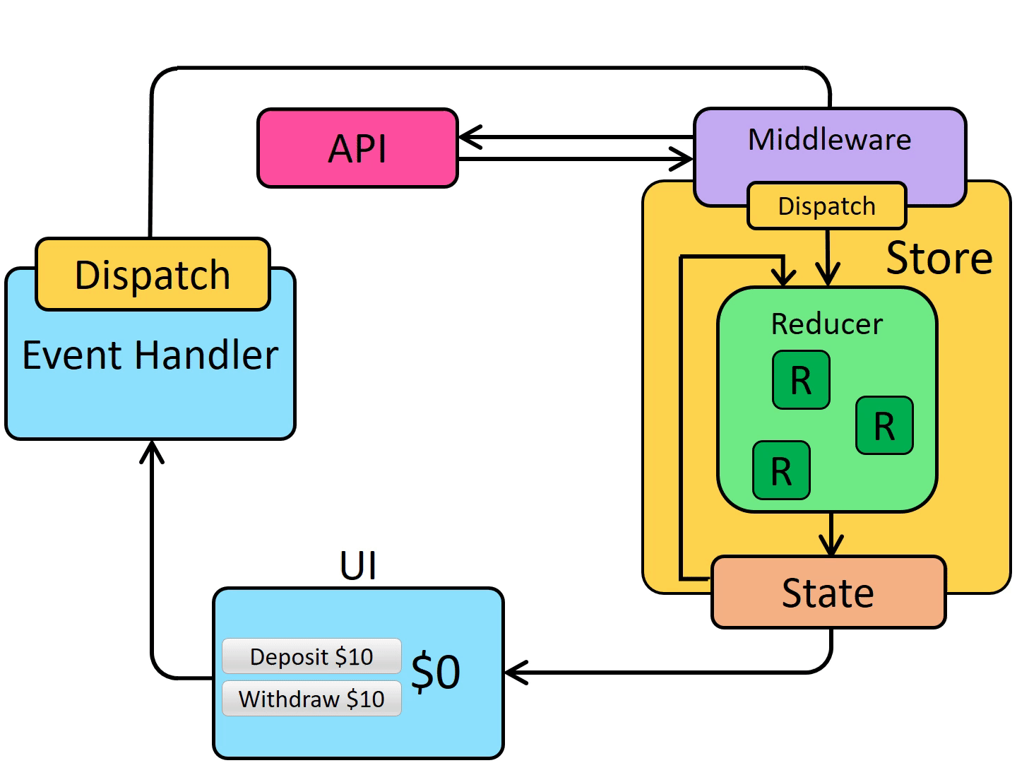
Redux Application Async Data Flow

Slide 78
Points to Remember
ActionTypes are used for Creating Action Objects and also helps reducer to recognize Action which is dispatched to it.
REACT COMPONENT -> DISPATCHER -> ACTION -> REDUCER -> STORE -> REACT COMPONENT
How Component will know about the Dispatch/Dispatcher?
Component uses connect() to get access to the Dispatch which is used in mapDispatchToProps()
In functional components we use useDispatch() Hook
How Component will know about the State?
Component uses connect() to get access to state which is used in mapStateToProps(),
In functional components we use useSelector() Hook
How Component will know about the Actions?
Component takes the actions (action Objects) to be performed from ActionCreators (counterActions, productActions)

Slide 79
Assignment / Practice
Complete the Requested and Failed logic for
Insert
Update
Delete
In the Redux application, consume the node-api-server and create a CRUD application using fetch-interceptor

Slide 80
Further Learning
Do it only after you have completed the code and assignments and comfortable with what we covered in the training

Slide 81
Redux Saga Middleware
Saga pattern is way a to handle long running transactions with side effects or potential failures.
Redux-saga is a redux middleware library, that is designed to make handling side effects in your redux app nice and simple.
It achieves this by leveraging an ES6 feature called Generators, allowing us to write asynchronous code that looks synchronous.

Slide 82
Thunk vs Saga
Thunk | Saga
Created by Redux Creator | Created by third party developers
Runs in any JavaScript Context | Only runs in ES6 environments that support yield
Has no built-in solution for asynchronous calls | Uses yield and generator functions to simplify async
No way to orchestrate side-effects between thunks | Uses effects and plain actions to coordinate sagas

Slide 83
React Hook Form
React Hook Form reduces the amount of code you need to write while removing unnecessary re-renders.
Features
Built with performance, UX and DX in mind
Embraces native HTML form validation
Out of the box integration with UI libraries
Small size and no dependencies
Support Yup, Zod, AJV, Superstruct, Joi, Vest, class-validator, io-ts, nope and custom build

Slide 84
React Component Libraries
React Bootstrap
React Material
Kendo React
Prime React
Syncfusion React

Slide 85
Redux Toolkit
https://redux-toolkit.js.org/

Slide 86
Contact Me
Manish Sharma | Gmail
Manish Sharma | WhatsApp
Manish Sharma | Facebook
Manish Sharma | LinkedIn

